Slide 1
SITE SOBRE JOGOS
KASSIO LUCAS DE HOLANDA
JOAO DE AREA LEAO NETO

Slide 2

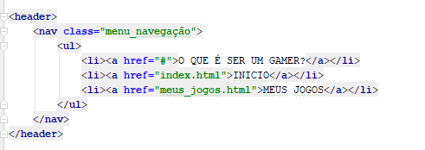
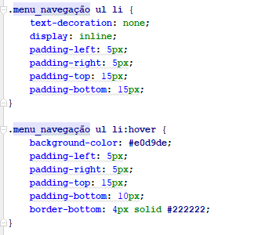

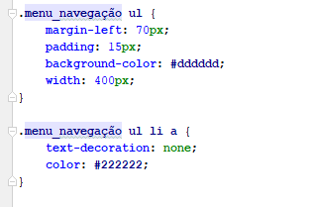
BARRA DE NAVEGAÇÃO

Slide 3
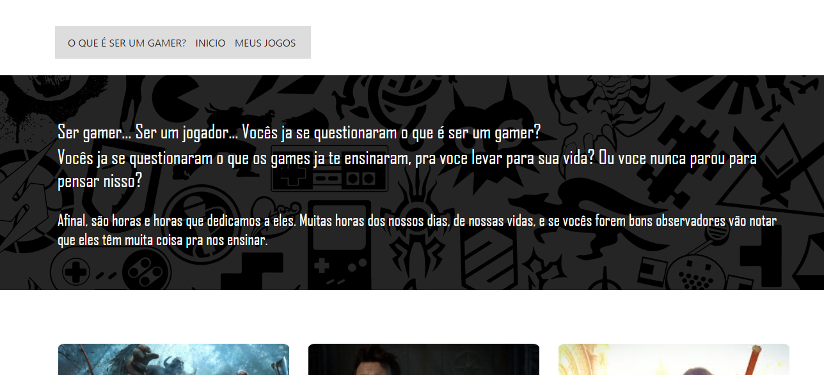
CARD PRINCIPAL

Slide 4
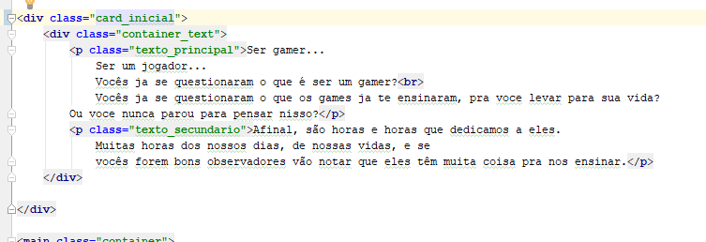
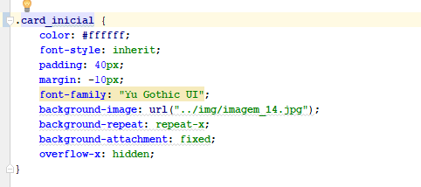
CARD PRINCIPAL

Slide 5
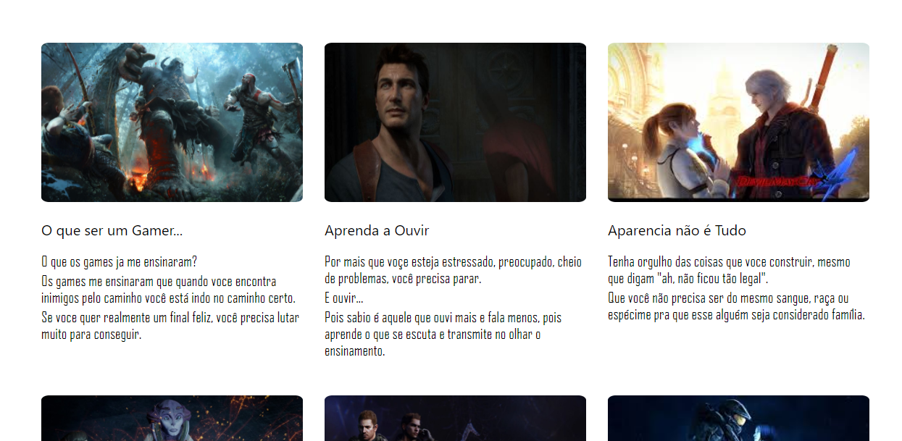
CONTEUDO PRINCIPAL

Slide 6
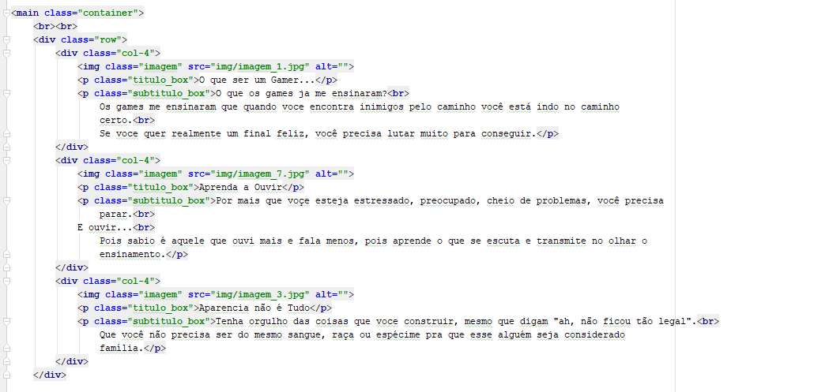
CONTEUDO PRINCIPAL

Slide 7
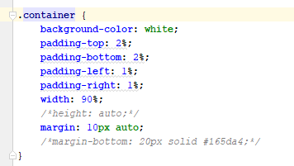
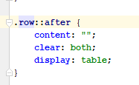



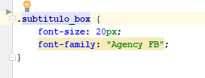
CONTEUDO PRINCIPAL

Slide 8
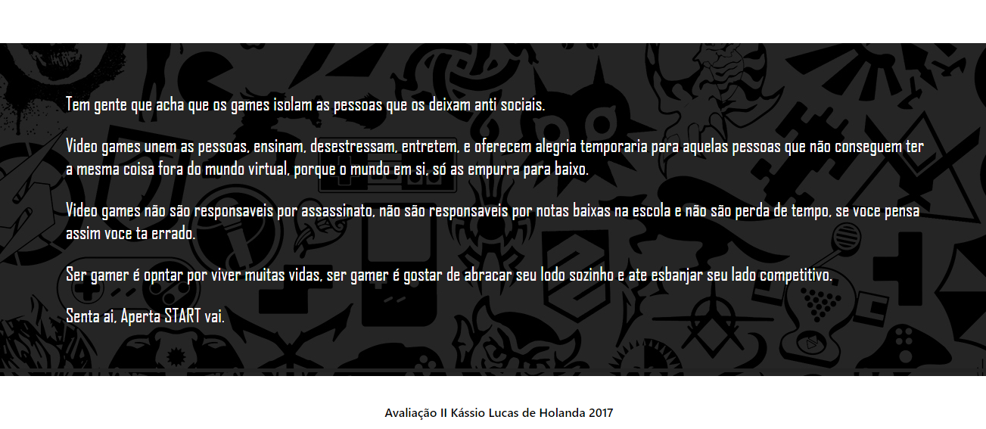
CARD FINAL

Slide 9


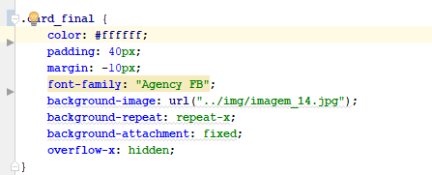
CARD FINAL

